Slide 1
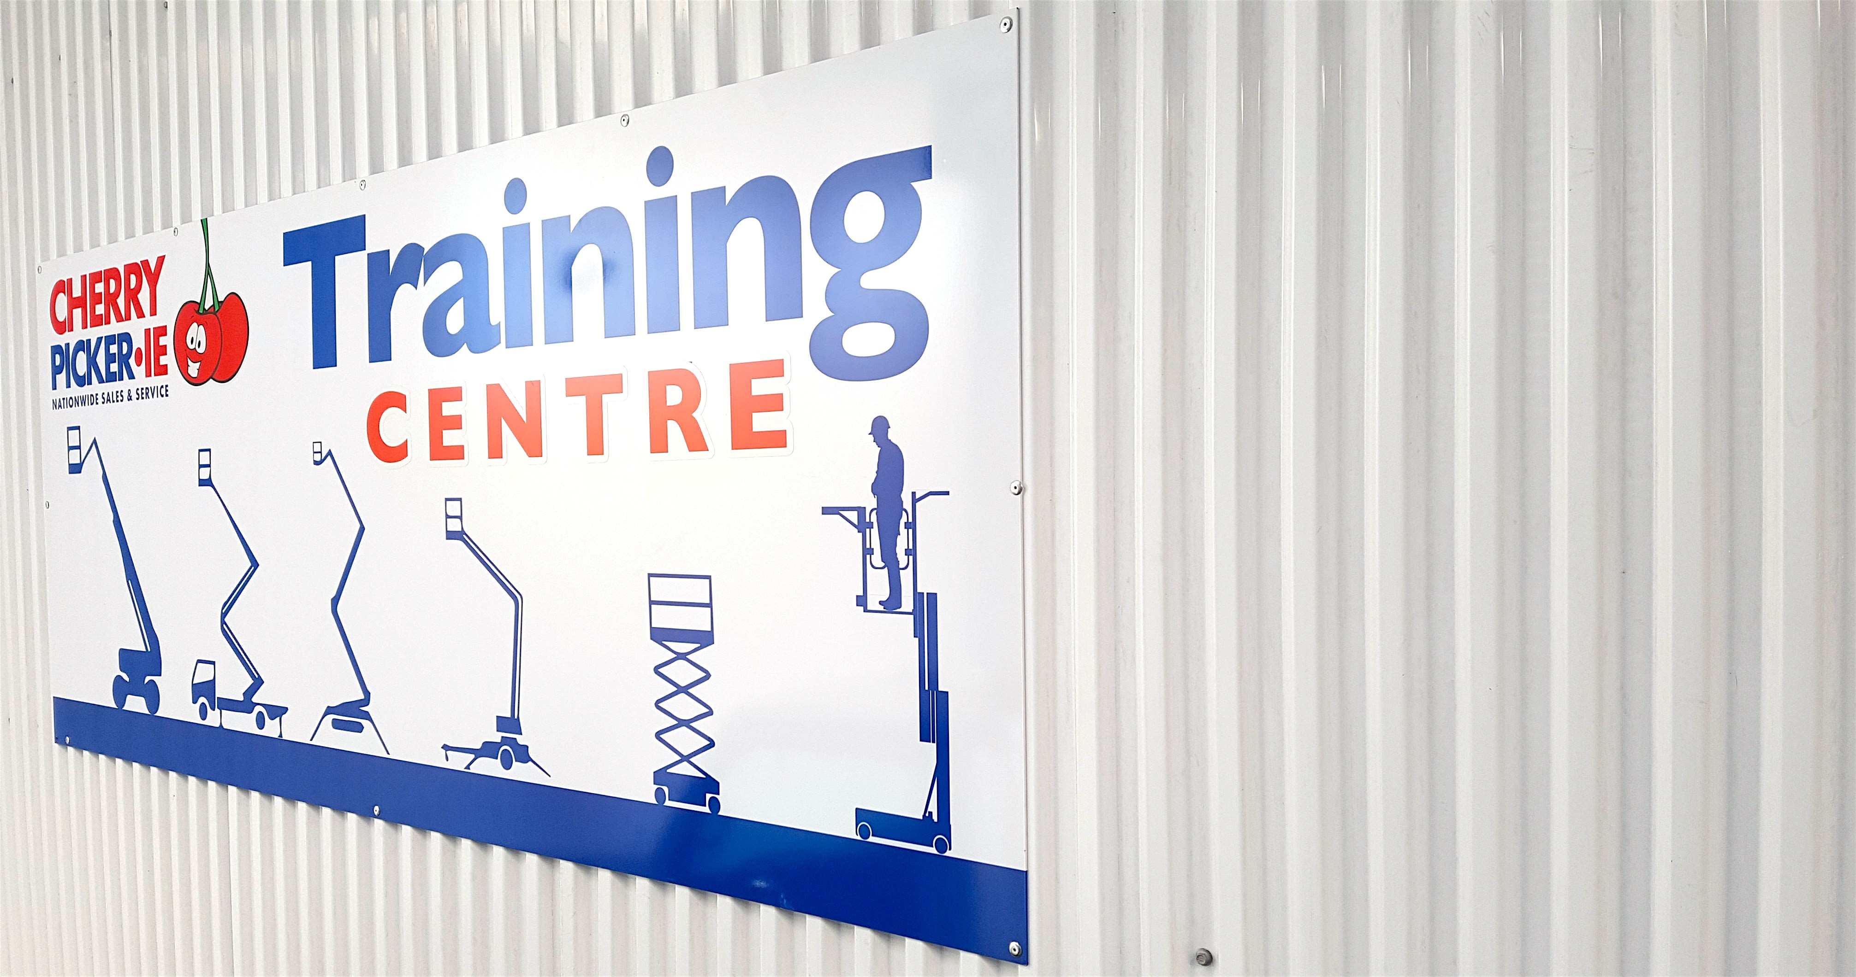
WORKING
AT
HEIGHTS

